Slide 1
Capacity management tool
Define data collection system

Slide 2
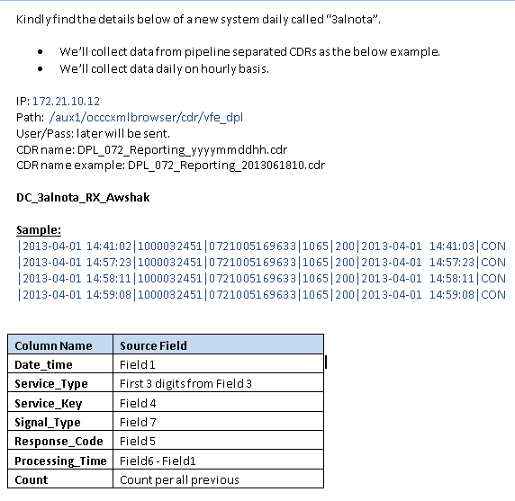
Data collection System configurations

Slide 3
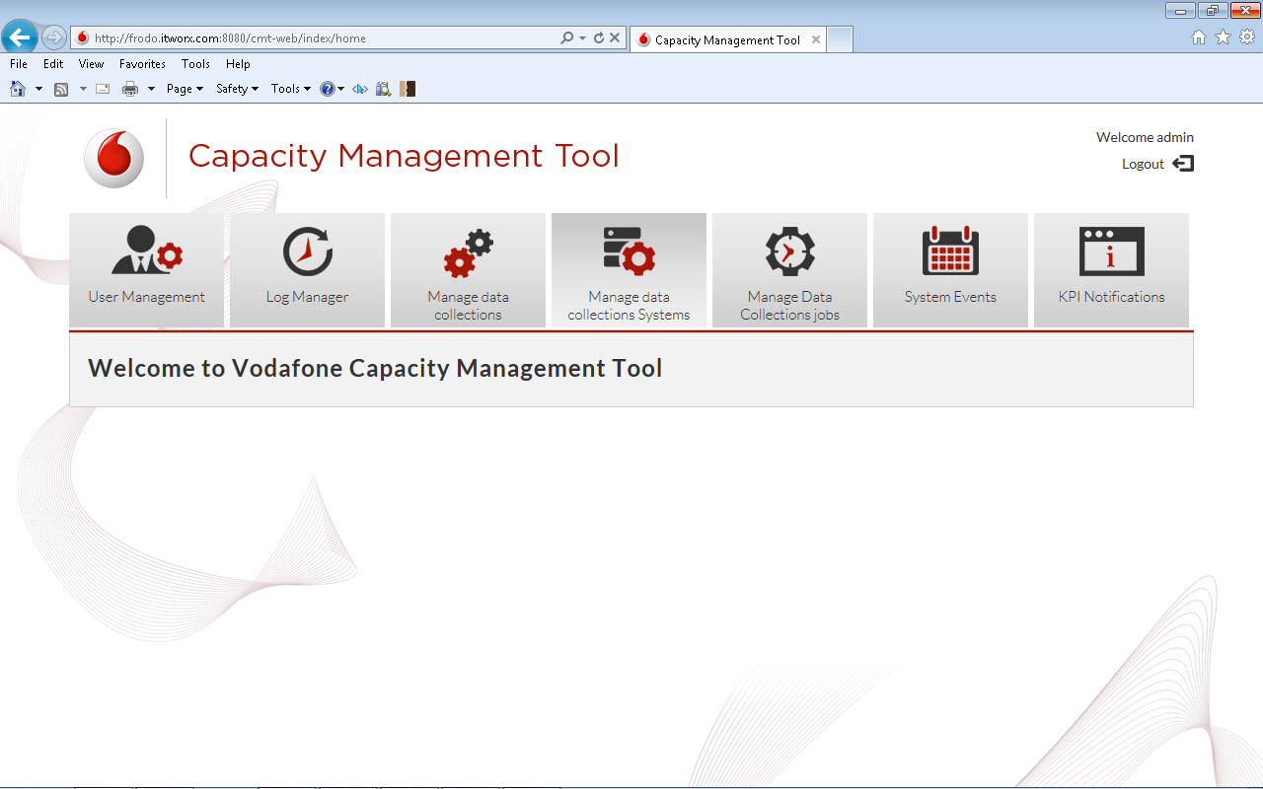
Open define new system form
Click “Manage Data Collection Systems” tab
1

Slide 4
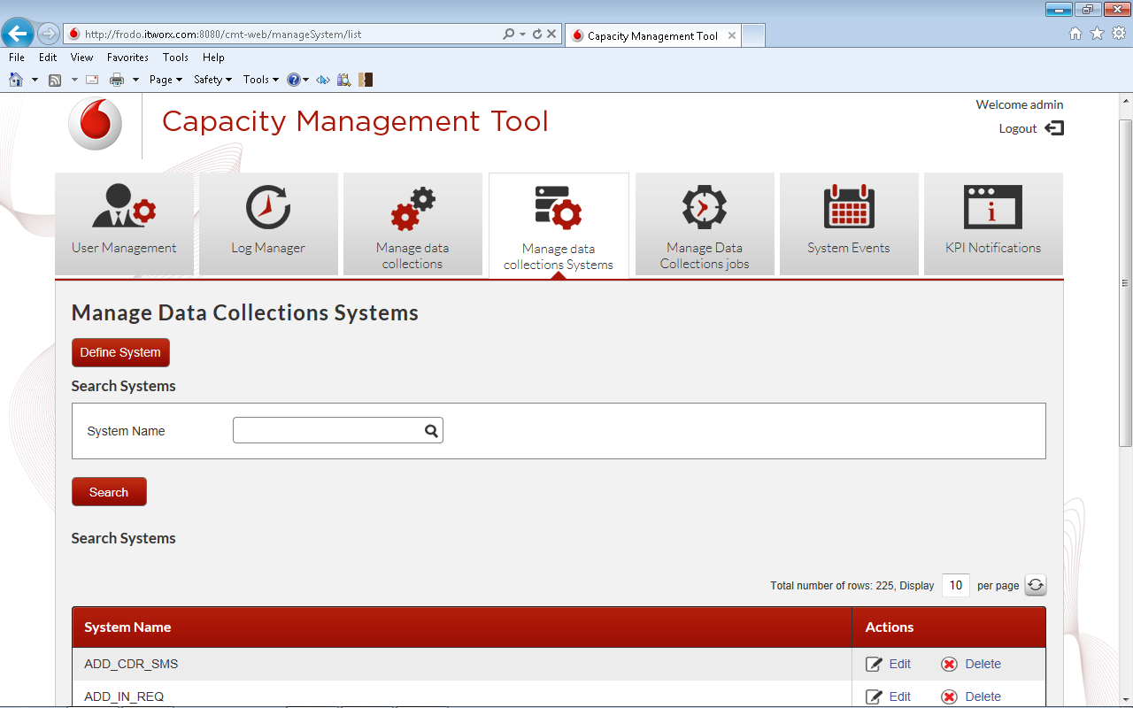
Open define new system form
2
Click “Define System” button

Slide 5
Define new System Form

Slide 6
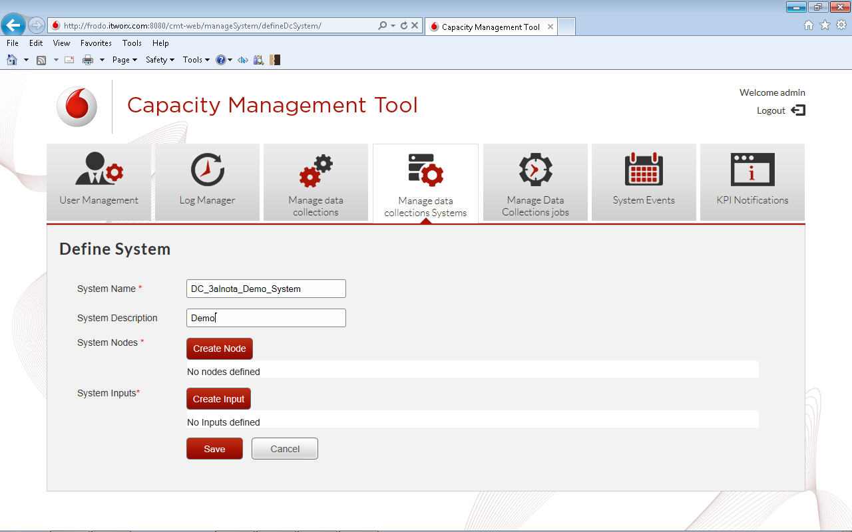
Define system form
1
Type system name
2
Type system description
3
Click “Create Node” button

Slide 7
Define new Node Form

Slide 8
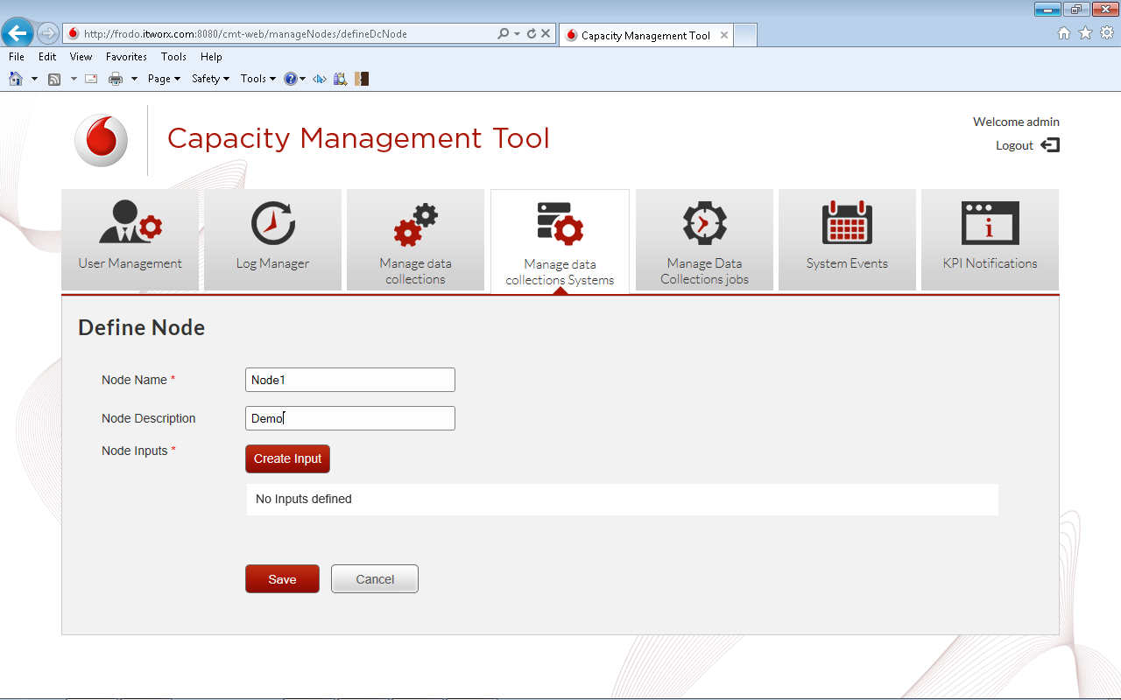
Define node form
1
Type Node name
2
Type Node description
3
Click “Create Input” button

Slide 9
Define new Input Form

Slide 10
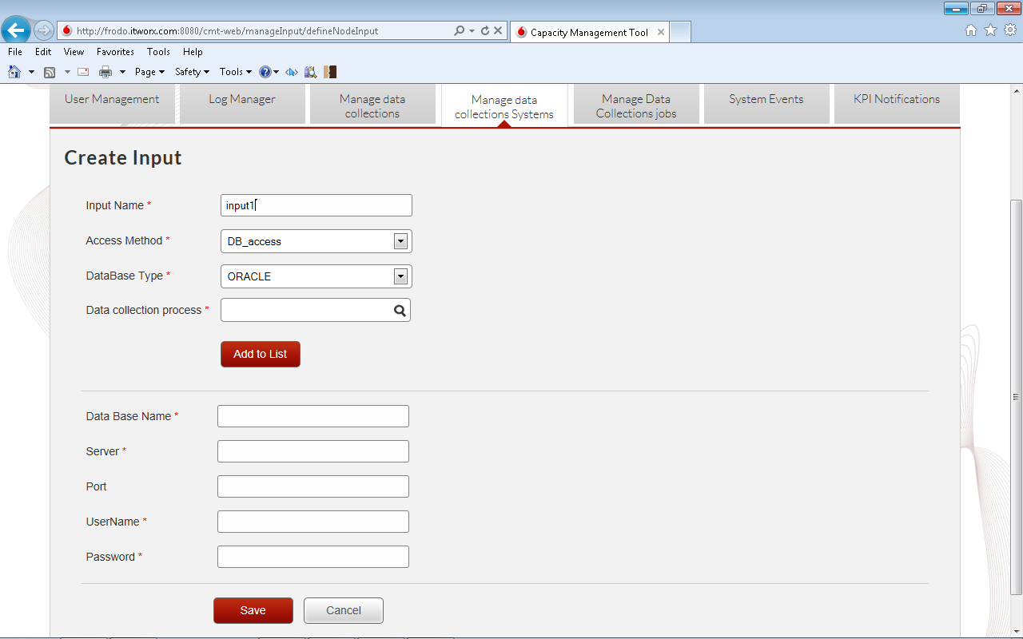
Define input form
1
Type Input name

Slide 11
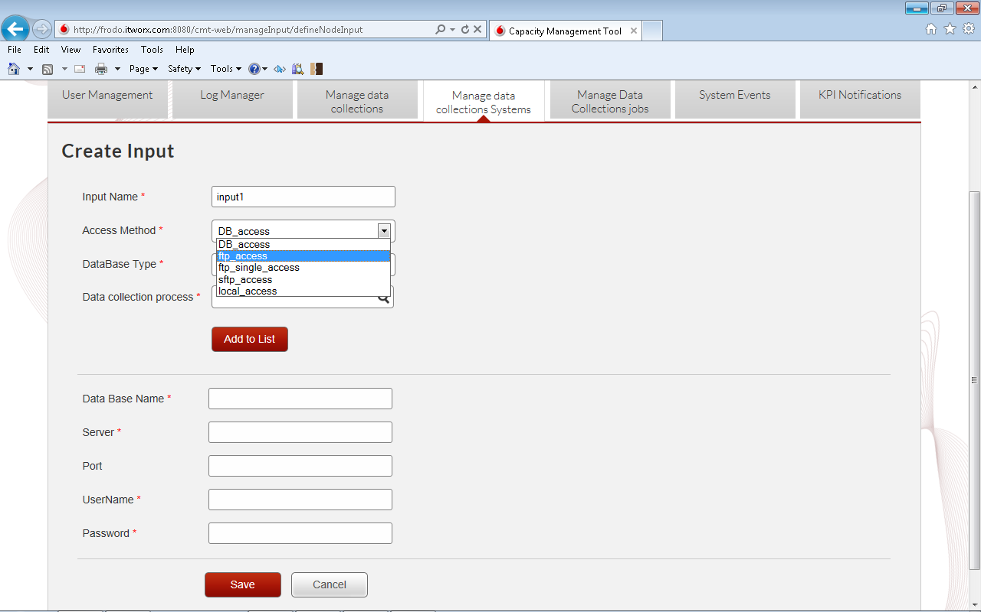
Define input form
Select access method “ftp access”
2

Slide 12
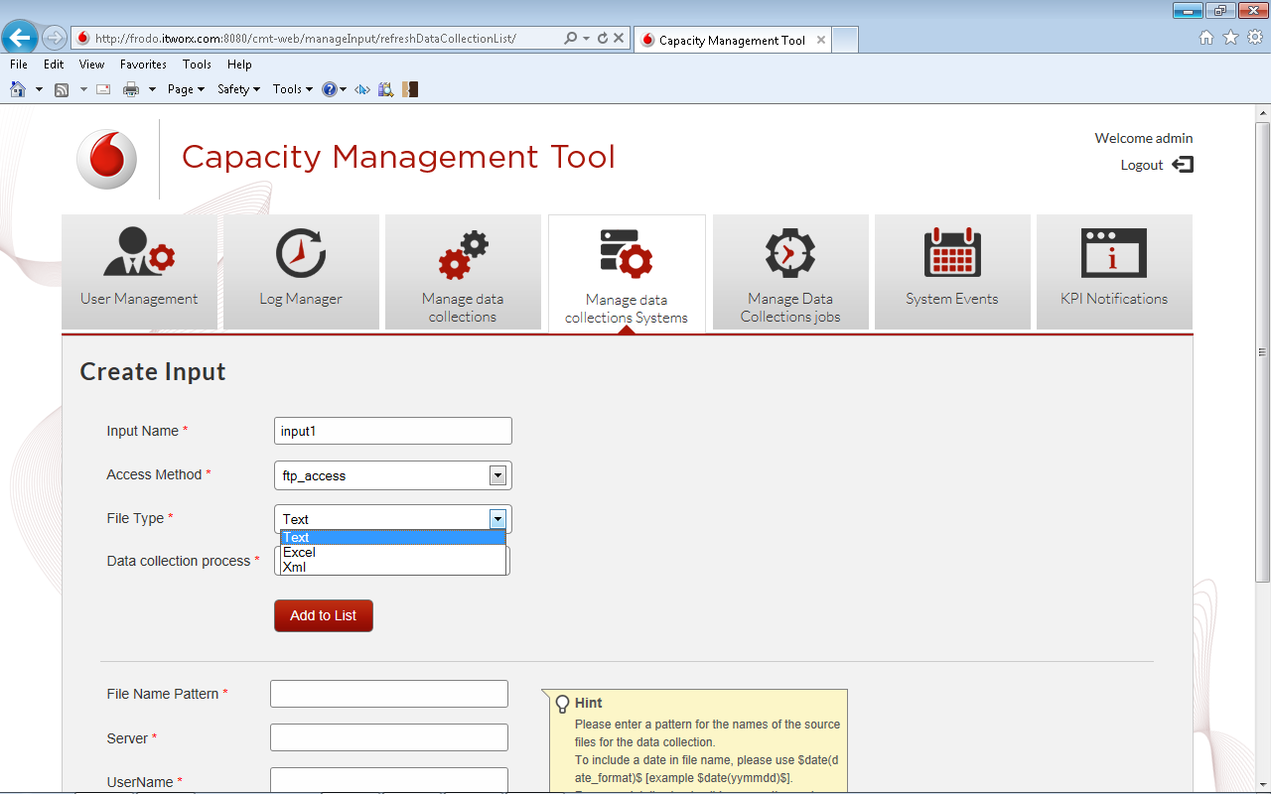
Define input form
Select file type “Text”
3

Slide 13
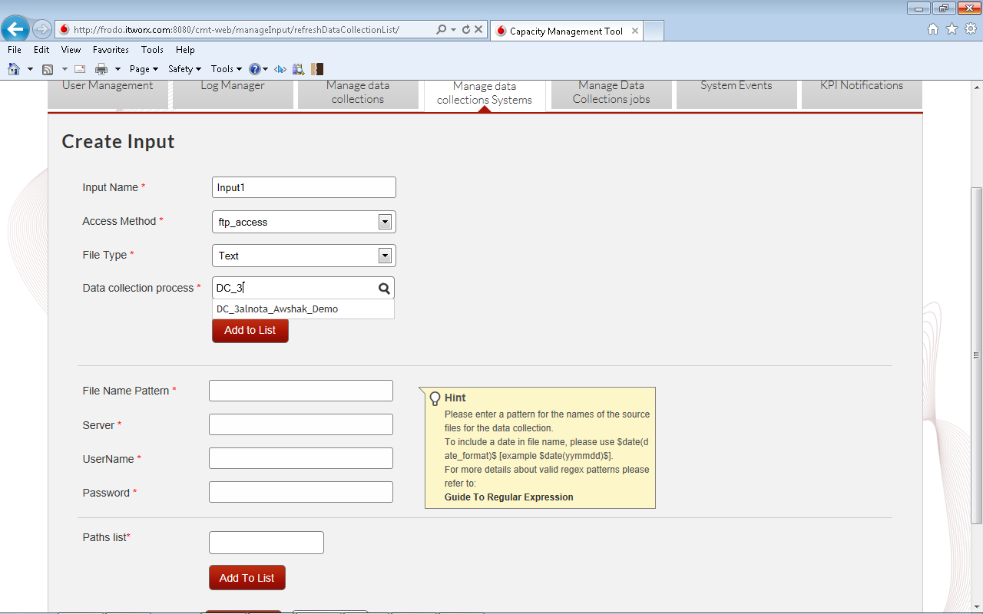
Define input form
Type the data collection name
4
Auto complete data collection name

Slide 14
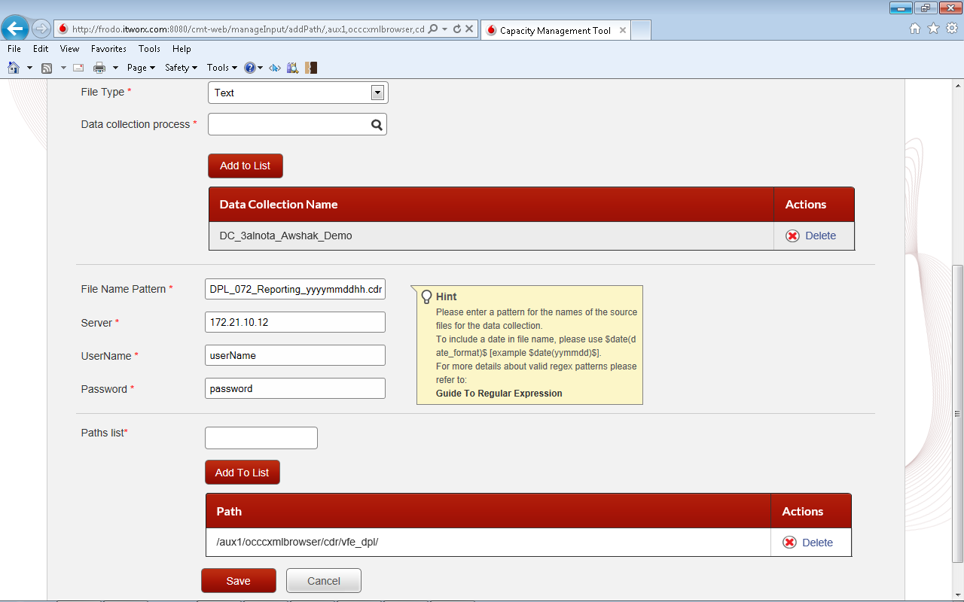
Define input form
5
Add server configurations
6
Add file path on server
Click save
7

Slide 15
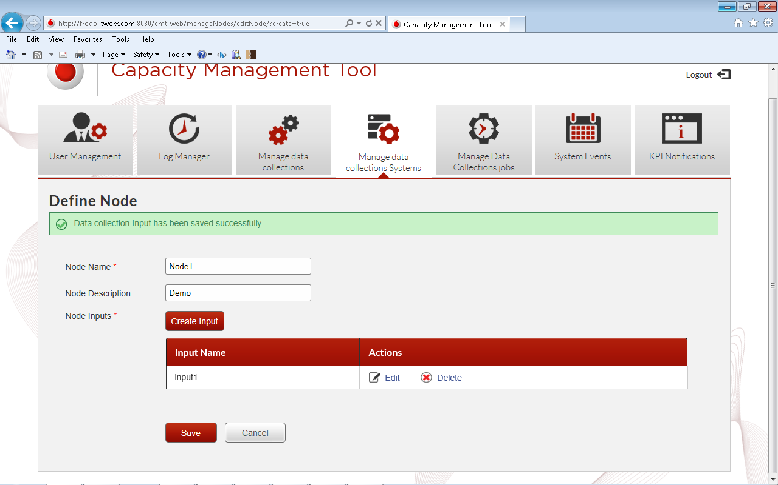
Define Node form
Click “save” to save node

Slide 16
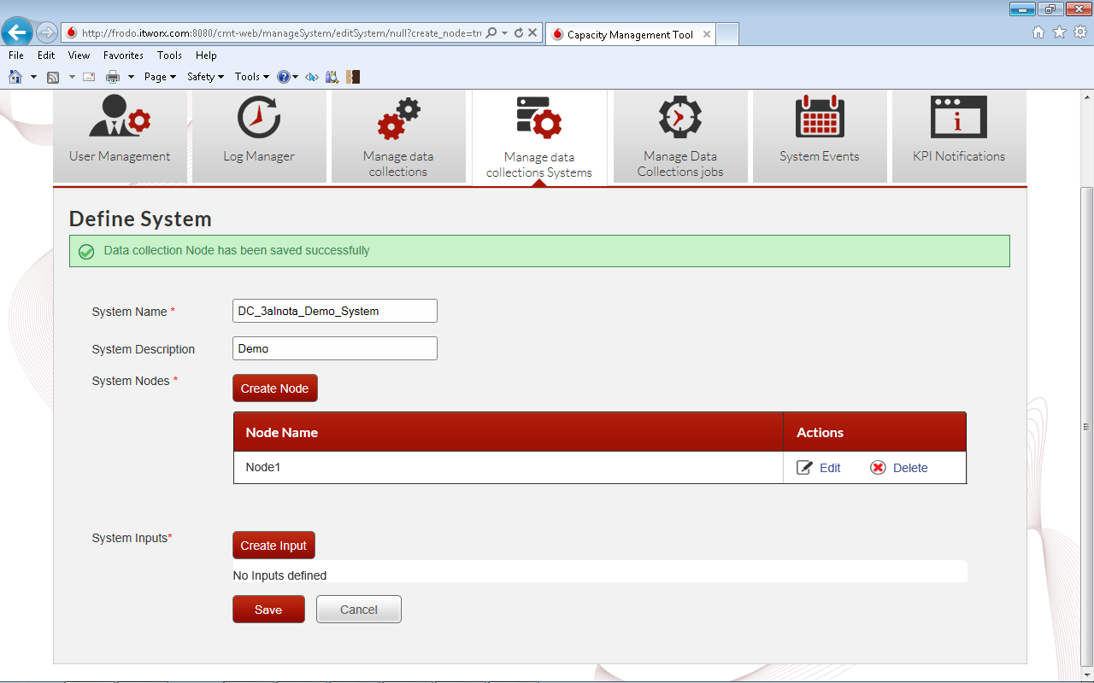
Define System form
Click “save” to save system

Slide 17
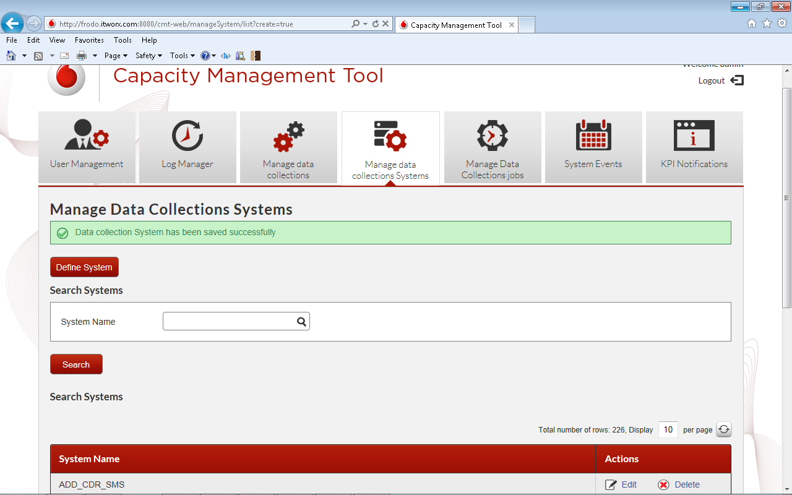
Done

